Slide 1

FED
WE
E
K
Frontend Security
Front End Development
Diploma in CSF
Year 1 (2021/22), Semester 2
13

Slide 2
Remote Learning Instructions
Step 1
Read the given slides
Details in slide 1-15
Step 2
Perform highlighted activities in Activities slide
Details in slide 14
Step 3
Complete and Submit Tasks given
Details in slide 15

Slide 3
Learning Objectives
At the end of this week’s practical exercise you will learn to:
Understand FrontEnd Security
Same Origin Policy
Cross Origin Resource Sharing (CORS)
Content Security Policy (CSP)
Protect against XSS vulnerability
Protect against CSRF vulnerability

Slide 4
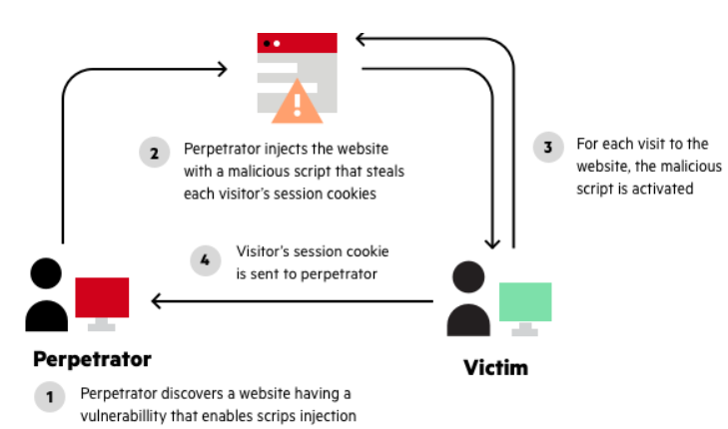
XSS Vulnerability
Ref: https://www.imperva.com/learn/application-security/reflected-xss-attacks/
Cross-site scripting (XSS) works by manipulating a vulnerable web site so that it returns malicious JavaScript to users.

Slide 5
XSS Vulnerability (cont)
When the malicious code executes inside a victim's browser, the attacker can fully compromise their interaction with the application.
Reflected XSS, where the malicious script comes from the current HTTP reques
Stored XSS, where the malicious script comes from the website's database.
Eg; eBay’s stored XSS exploit (https://news.netcraft.com/archives/2017/02/17/hackers-still-exploiting-ebays-stored-xss-vulnerabilities-in-2017.html)

Slide 6
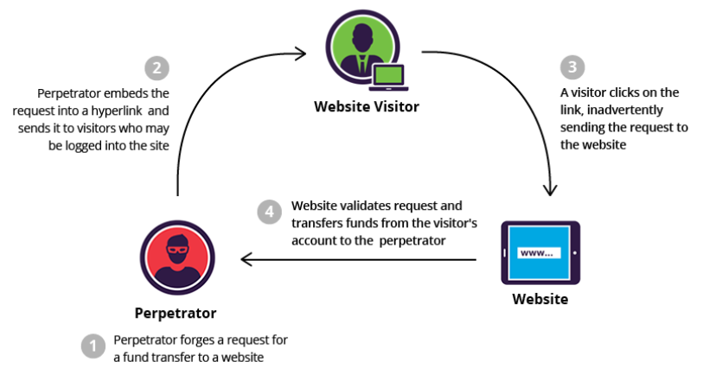
CSRF Vulnerability
Ref: https://www.imperva.com/learn/application-security/csrf-cross-site-request-forgery/
Cross-site request forgery (also known as CSRF) is a web security vulnerability that allows an attacker to induce users to perform actions that they do not intend to perform.

Slide 7
CSRF Vulnerability (cont)
CSRF commonly has the following characteristics:
It involves sites that rely on a user's identity.
It exploits the site's trust in that identity.
It tricks the user's browser into sending HTTP requests to a target site.
It involves HTTP requests that have side effects.
Eg; Netflix CSRF Vulnerability (http://www.internetnews.com/skerner/2008/02/black-hat-netflix-csrf-vulnera.html)

Slide 8
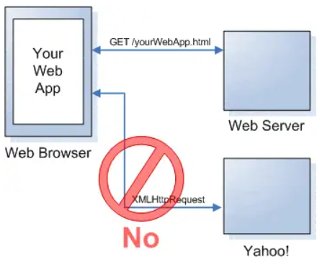
FrontEnd Security
Same Origin Policy (SOP)
Cross Origin Resource Sharing (CORS)
Content Security Policy (CSP)
Ref: https://danielmiessler.com/study/same_origin_policy/

Slide 9
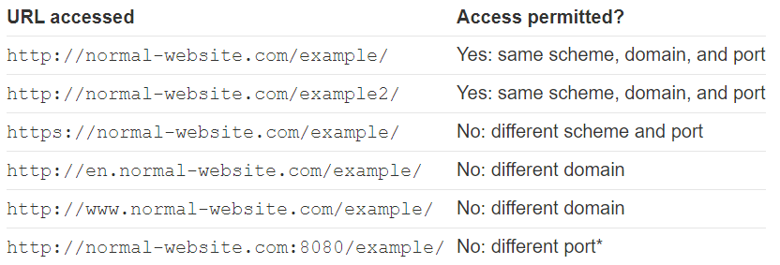
What is the same-origin policy (SOP)?
The same-origin policy (SOP) is a web browser security mechanism that aims to prevent websites from attacking each other.
Same-origin policy restricts scripts on one origin from accessing data from another origin.

Slide 10
What is Cross Origin Resource Sharing (CORS)?
Many websites interact with subdomains or third-party sites in a way that requires full cross-origin access.
A controlled relaxation of the same-origin policy (SOP) is possible using cross-origin resource sharing (CORS).
Cross-origin resource sharing (CORS) is a browser mechanism which enables controlled access to resources located outside of a given domain.

Slide 11
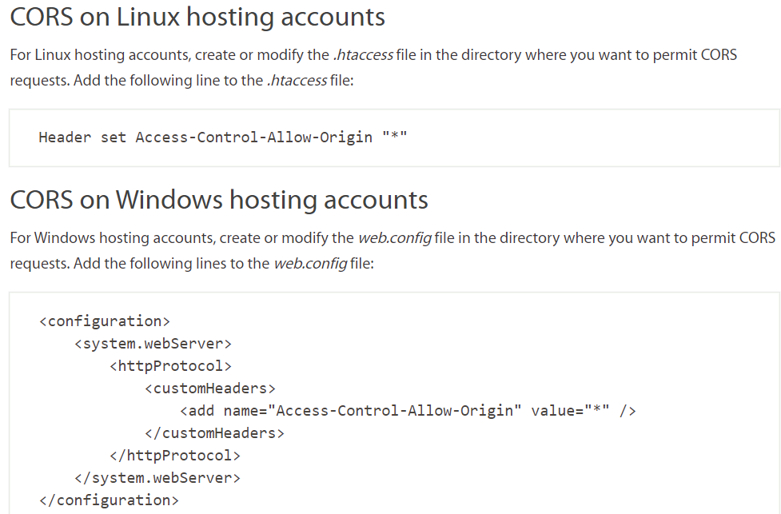
Enable Cross Origin Resource Sharing (CORS)
Ref: https://www.a2hosting.sg/kb/developer-corner/enabling-cross-origin-resource-sharing

Slide 12
Content Security Policy (CSP)
To enable CSP, you need to configure your web server to return the Content-Security-Policy HTTP header.
Content Security Policy (CSP) is an added layer of security that helps to detect and mitigate certain types of attacks, including Cross Site Scripting (XSS) and data injection attacks.
These attacks are used for everything from data theft to site defacement to distribution of malware.
To enable CSP, you need to configure your web server to return the Content-Security-Policy HTTP header.

Slide 13
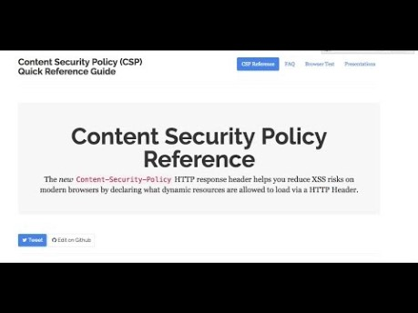
Content Security Policy (CSP)
Ref: https://www.youtube.com/watch?v=pBKB4wsQK48

Slide 14
Activities
Read the following references:-
Cross Site Scripting (XSS) - https://www.imperva.com/learn/application-security/cross-site-scripting-xss-attacks/
Cross Site Request Forgery (CSRF) https://www.imperva.com/learn/application-security/csrf-cross-site-request-forgery/
Same-Origin-Policy - https://portswigger.net/web-security/cors/same-origin-policy
Cross Origin Resource Sharing (CORS) - https://portswigger.net/web-security/cors
Watch Content Security Policy
https://www.youtube.com/watch?v=pBKB4wsQK48

Slide 15
Tasks
Complete Week 13 Practical.
Download Week 13 Practical in MEL – “FED 2021-10 Week 13 Worksheet.pdf”
Deadline end of Week 13
Submit the completed practical files in MEL.
Zipped the source files
Name the zipped file in following format:-
FED-Week13-SXXXXXXXX (where SXXXXXXXX is your student id)
Submit the zipped file in the weekly folder’s submission link in MEL
Also, submit the zipped file into FED network folder (\\ictspace.ict.np.edu.sg\FED) under your studentID. This is for backup purpose only. Main submission is still in MEL.
If you have any questions please communicate with your tutor via Microsoft Teams.

